Slide 1

H172 35 - Object Oriented Analysis and Design
Activity Diagrams

Slide 2
Activity Diagrams
Activity diagrams give a much more detailed view of a piece of functionality compared with Use Case Diagrams
Activity diagrams are created during design stage
They offer a step-by-step flow of what needs to happen for a function in your app to work
E.g. if the use case was called “login” an Activity diagram would map out the individual stages that a user would go through in order in order to successfully login
A user would:
Enter their username and password
Click the Login button
The System would verify that the username / password was correct
IF the credentials were ok it would take them to home page
IF the credentials were wrong it would show a login error

Slide 3

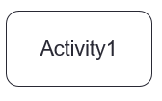
Basic Components in an Activity Diagram
Start Node
The filled circle is the starting point of the diagram
Activity
The rounded circle represents activities that occur in the system
Flow
Lines with arrows depict the direction to travel along
i.e. the flow

Slide 4
Basic Components in an Activity Diagram
Decision Diamond
A diamond with one flow entering and two leaving
The direction that the flow leaves on depends on the Boolean answer (i.e. True or False) from the decision
Only one path can be taken at a time
E.g. A decision stage on an ATM machine when a user wishes to withdraw cash could be:
“Enough funds in account” OR “Insufficient funds”
The resulting actions from each would be very different!

Slide 5

Basic Components in an Activity Diagram
End node
The filled circle with a border is the ending point for the activity diagram
Use this for the good ending of the activity
E.g. if the activity was “Login” then the ideal situation for both user and system is that the user enters correct login info and is logged in and taken to the home page
That’s the ideal ending
Termination Node
This indicates that a particular flow (process) stops at this point because it can go no further
Usually associated with a bad ending
Not the ideal ending for the activity
E.g. an ATM machine will reject your card if you enter the wrong pin
But this isn’t the ideal end of a transaction in an ATM – the user wanted money!

Slide 6
Notation – Start and End
Start Node
Flow comes from the final activity
End Node
Flow now moves on to an activity

Slide 7
Notation – Basic Activity Flow
Start
2. Flow
Activity 1
Activity 2
Send Payment
Display Receipt
1. Activities
Stop

Slide 8
Notation - Decisions
[Option A]
Activity 1
[Text Explaining Decision]
A decision must be made to determine
which path to follow
[Option B]
Select Room
[Yes]
Book Hotel
Room
[Are Rooms Available?]
[No]

Slide 9
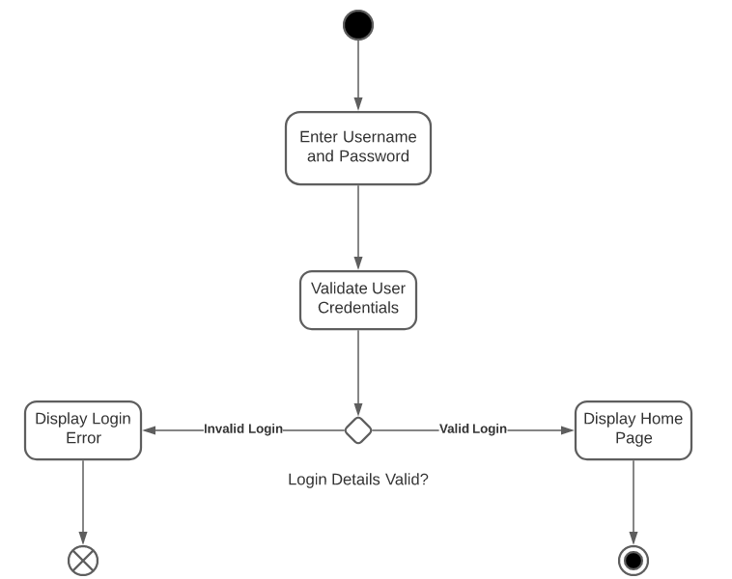
Example – Logging In

Slide 10
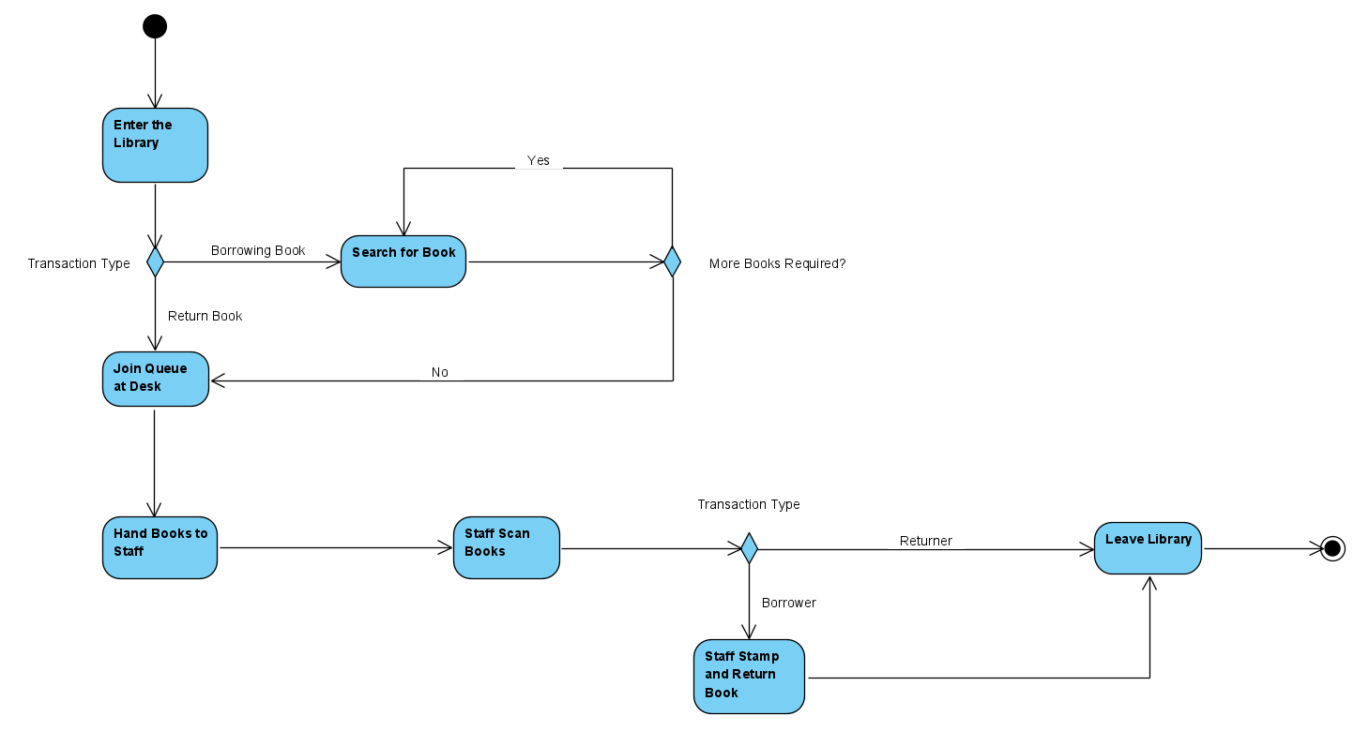
Example – Library Activity Diagram

Slide 11
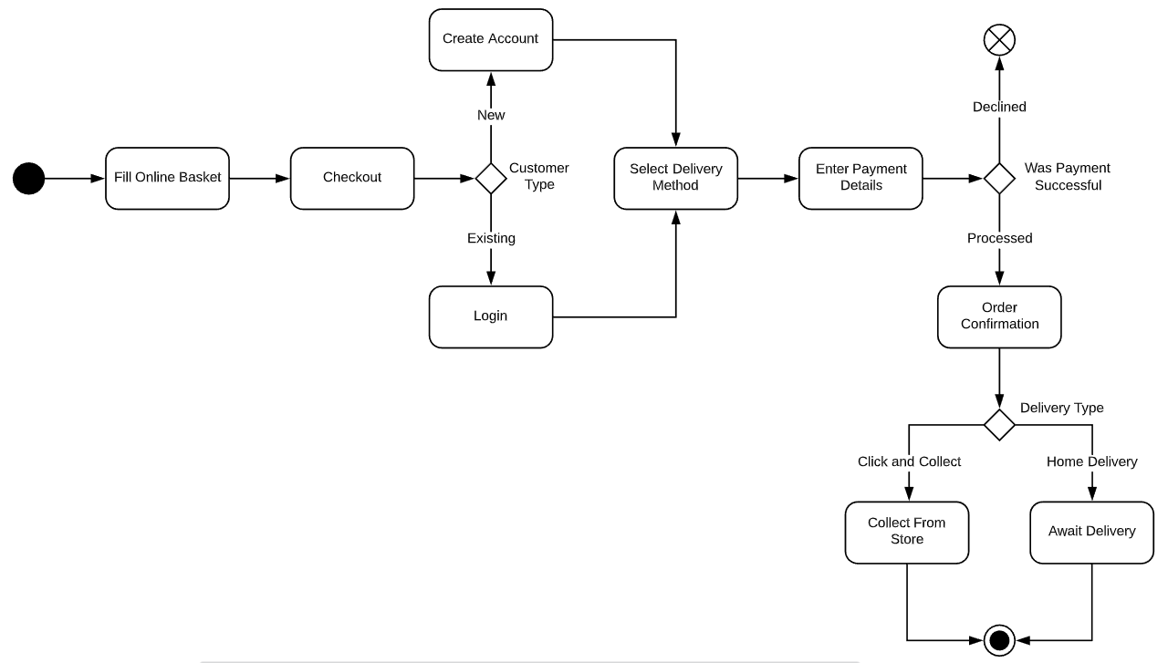
Example – Online Shop Order

Slide 12
Swim Lanes
Swim Lanes add extra clarity by detailing who does what in the activity diagram
Swim Lanes separate the activities in a diagram to show
User actions
System actions
3rd Party Systems actions

Slide 13
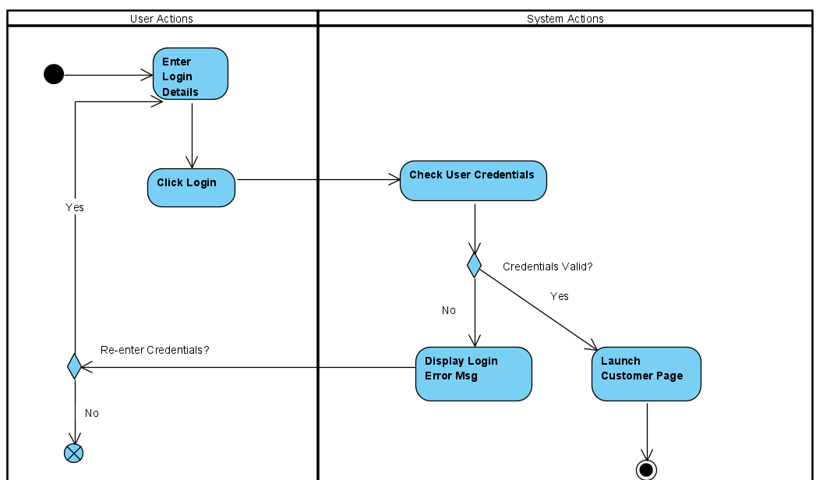
Swim Lanes Example

